Slide 1
Chapter 18 (Part 2): Semiconductors

Slide 2
Objectives
After completing Part 2 of this chapter, you will be able to:
To understand the V-I Characteristics of a Diode.
To understand the Practical Diode Model.
To perform calculations to find the voltage and current in a diode circuit.

Slide 3
The PN Junction Diode
A diode is a device that allows current to flow in one direction but not the opposite direction
Because of the above capability, a p-n junction is also known as a p-n junction diode or a rectifier diode or simply, a diode
Symbol
p-region
n-region
Anode (+)
Cathode ( - )

Slide 4
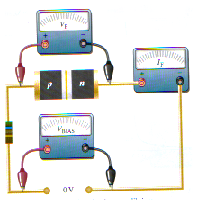
18-8 V-I Characteristics of Diode
Experimental Setup
V_{BIAS} = 0 V
Hence V_{F} = 0 V
I_{F} = 0 A
No current flows
V_{BIAS} = 0V

Slide 5
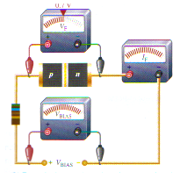
V-I Characteristics of Diode
Forward Bias Condition
0.7V
V_{BIAS} is large
Hence V_{F} = 0.7V
Forward current I_{F} is large
+V_{BIAS}

Slide 6
Forward Bias
V-I Characteristics of Diode
Forward current very small when forward voltage across diode < 0.7 V
Beyond this point, forward voltage remains at approximately 0.7 V, but I_{F} increases rapidly
Normal operation for a forward-biased diode is above the knee of the curve (at point C)
Graphically,
I_{F} (mA)
C
Knee
A
B
0.7V
V_{F}

Slide 7
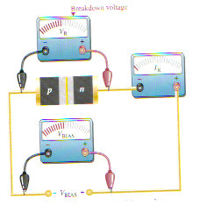
Reverse Bias
V-I Characteristics of Diode
Breakdown voltage
V_{BIAS} is reversed and not too large (<50V)
V_{R} < breakdown value
I_{R} is extremely small
V_{BIAS} +

Slide 8
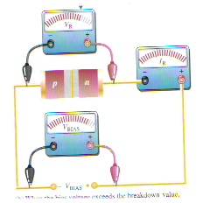
Reverse Bias
V-I Characteristics of Diode
Breakdown voltage
V_{BIAS} is reversed and large (>50V)
V_{R} > breakdown value
I_{R} rapidly increases and may get out of control
Excessive heat generated can destroy the semi-conductor
V_{BIAS} +
We DO NOT operate a Diode at V_{R} > V_{BR}

Slide 9
Reverse Bias
V-I Characteristics of Diode
When V_{R} is applied to diode, only an extremely small reverse current (I_{R}) is present.
When V_{R} increases, I_{R} remains very small but voltage across the diode increases.
Graphically,
V_{R}
V_{BR}
Knee
A
B
Once V_{R} reaches breakdown value (V_{BR}), the reverse current begins to increase rapidly.
I_{R} (μA)

Slide 10
Complete Curve
V-I Characteristics of Diode
Combining the 2 curves:
I_{F} (mA)
V_{BR}
V_{R}
V_{F}
Knee
0.7V
Notice that I_{F} scale is in mA while I_{R} scale is in μA.
I_{R} (μA)

Slide 11
V-I Characteristics for Diode
18-9 Practical Diode Model
Instead of the combined curve in the previous slide, a practical diode model is usually used for circuit calculation
I_{F}
0
V_{R}
0
0.7 V
V_{F}
I_{R}

Slide 12
Forward Bias
Practical Diode Model
+V_{F} -
When diode is forward-biased, it acts as a closed switch in series with a small voltage, V_{F.}
V_{F}=0.7V (Silicon)
V_{F}=0.3V (Germanium)
A
K
R
I_{F}
+V_{BIAS} -
Using Kirchoff’s Voltage Law,
V_{BIAS} = I_{F}R + V_{F}

Slide 13
Reverse Bias
Practical Diode Model
A
K
When the diode is reverse-biased, it acts as an open switch
V_{BIAS} +
R
I = 0
V_{BIAS} +
I_{R} = 0 A V_{DIODE} = V_{BIAS}

Slide 14
EXAMPLE 18-1
Determine the forward voltage and forward current for the diode below using the practical diode model.
Find the voltage across the limiting resistor.
R
Solution
Using the practical diode model, V_{F} = 0.7V
+
V_{BIAS}
1KΩ
+
0.7V
-
8V
V_{R} = I_{F} R = (7.3 mA)(1 kΩ) = 7.3 V

Slide 15
Practical Diode Model
EXAMPLE 18-2
Determine
the diode voltage and diode current for the diode below using the practical diode model.
the voltage across the limiting resistor.
R
Solution
Using the practical diode model:
I_{R} = 0 A
V_{DIODE} = V_{BIAS} = 8V
V_{RESISTOR} = 0V
+
V_{BIAS}
1KΩ
8V

Slide 16
Summary
A diode is a device that allows current to flow in one direction but not the opposite direction
Since a PN junction allows current to flow in one direction (when it is forward biased) but not the opposite direction (when it is reversed biased), a pn junction is also known a diode
The diode forward current is very small when its forward voltage is less than 0.7V
When a diode is forward biased, its forward voltage is equal to its barrier potential of 0.7V while its forward current increases exponentially with an increase in the bias voltage

Slide 17
Summary
When a diode is reversed biased, with the bias voltage below its breakdown voltage, its reverse voltage is equal to the bias voltage while its reverse current is extremely small (almost zero) and remains constant
Once the reverse voltage reaches the diode’s breakdown voltage, the reverse current begins to increase rapidly
In the Practical Diode Model, the forward voltage is equal to 0.7V while the reverse current is equal to zero

Slide 18
End of Chapter 18

